Slide 1

Analyzing Sales Performance of a Superstore using Tableau
11021210023
Raghav Chandhok

Slide 2

Project Overview
1
Objective
2
Dataset
3
Tool
Analyze superstore sales data to identify key trends and patterns for informed business decisions.
Comprehensive sales, customer, product, and location data will be analyzed.
Tableau will be used for interactive reporting and data exploration.

Slide 3

Methodology
1
Data Collection
Gather sales data from the superstore database.
2
Data Analysis
Use Tableau to process and analyze the collected data.
3
Visualization
Create charts and graphs to illustrate sales performance.
4
Reporting
Compile findings into an interactive Tableau report.

Slide 4
Superstore Data Set Columns
1
Order ID
2
Order Date
3
Ship Date
Unique identifier for each sales order
Date the order was placed
Date the order was shipped
4
Ship Mode
5
Customer Name
6
Segment
Shipping method used (Standard Class, Second Class, First Class, etc.)
Name of the customer who placed the order
Customer segment (Consumer, Corporate, Home Office)
7
Country
8
City
9
State
Country where the order was placed
City where the order was placed
State where the order was placed
10
Postal Code
11
Region
12
Product ID
Postal code of the order location
Geographic region (East, West, Central, South)
Unique identifier for each product
13
Category
14
Sub-Category
15
Product Name
Product category (Furniture, Office Supplies, Technology)
More specific product subcategory
Name of the product ordered
16
Quantity
17
Discount
18
Profit
Number of units ordered
Discount percentage applied to the order
Profit generated from the order
19
Sales
Total sales amount for the order

Slide 5

Key Findings
Total Sales
Profit Analysis
Top Categories
Total revenue generated was $2,326,534.
An average discount of 16.5% was applied across all orders.
Technology contributed the most to overall sales, accounting for 45% of the total.
A total of 10,194 products were sold.
The profit ratio for the superstore was 12.8%.
The total profit was $297,517.
Within the Technology category, Copiers and Phones were the leading subcategories.
Furniture and Office Supplies followed closely behind as the next highest contributing categories.

Slide 6
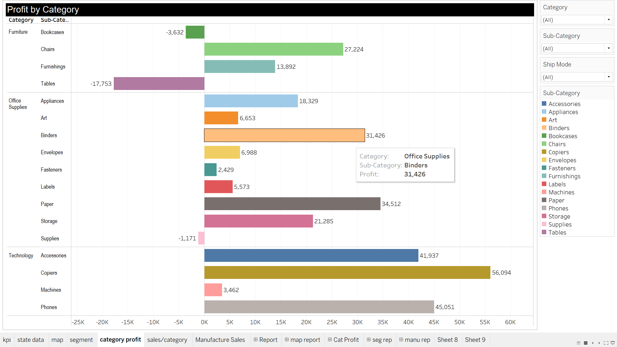
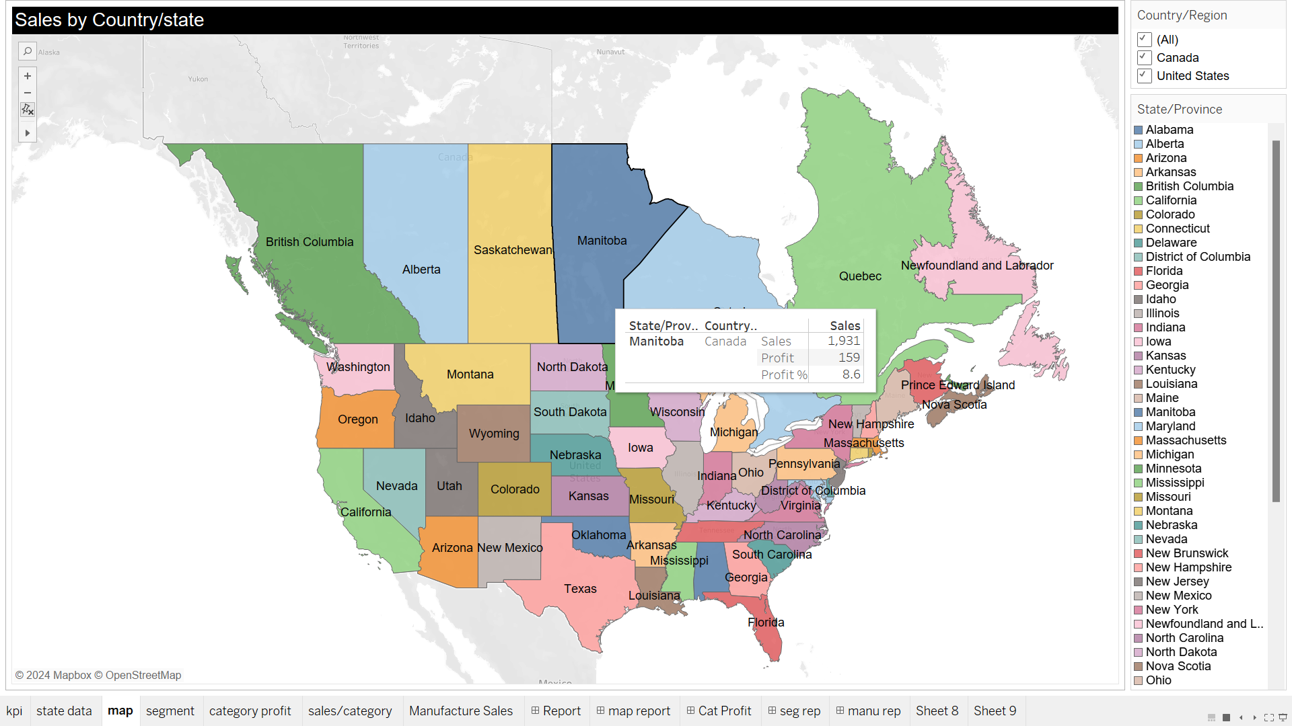
Visualization Examples
Profit by Subcategory
Geographic Sales
Illustrate profit distribution across product types.
Display sales performance across different regions.

Slide 7





Benefits of Tableau Analysis
Visual Insights
Interactive Reports
Informed Decisions
Faster Analysis
Easy-to-understand visual representations of complex data.
Dynamic dashboards for exploring data in real-time.
Data-driven insights to guide business strategies.
Accelerate data exploration and analysis with intuitive tools.
Collaboration
Share insights and collaborate effectively with stakeholders.

Slide 8

Conclusion
Valuable Insights: Tableau report provides crucial information on superstore performance.
Decision Support: Findings help optimize sales and maximize profits.
Visual Communication: Data presented in an easily understandable, visually compelling way.
Improved Efficiency: Tableau simplifies data analysis and reporting, saving time and resources.
Data-driven Decisions: Insights from Tableau inform strategic planning and operational adjustments.

Slide 9
Thank You

